Slide 1

PowerBI Enterprise Project Server 2016 and Project Online Reporting
Presented by
Hari Prasad Thapliyal
Agilest & Project Management Trainer, Coach & Consultant
(MBA, MCA, PGDOM, PGDFM, CIC, PMP, PMI-ACP, CSM, SCPO, SDC
PRINCE2-Trainer, Scrum Certified Trainer, Microsoft Certified Trainer, ZED Master Trainer)

Slide 2
Although PowerBI can be used to connect to many kind of data stores and generate many kind of dashboard, reports and perform analysis. But in this presentation I am limiting myself to “Project Online”

Slide 3
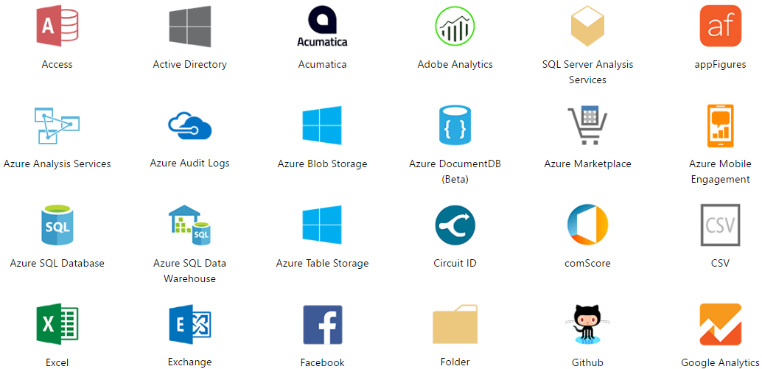
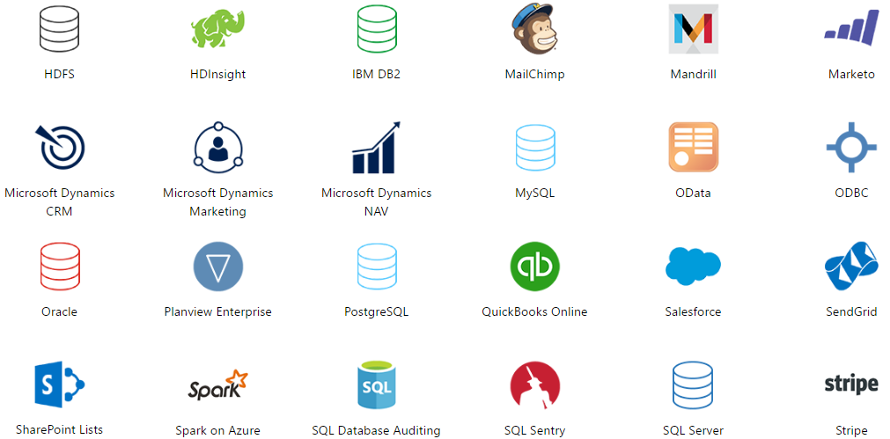
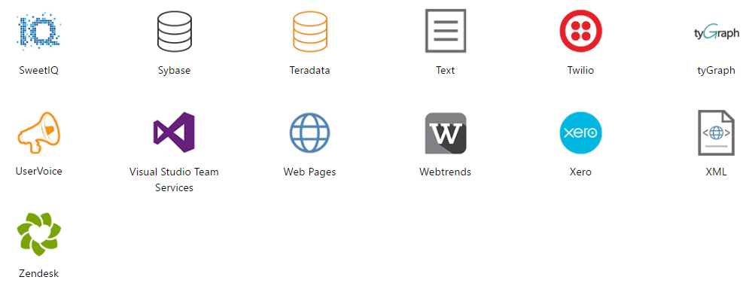
PowerBI can Connect to many database/store/serives

Slide 4
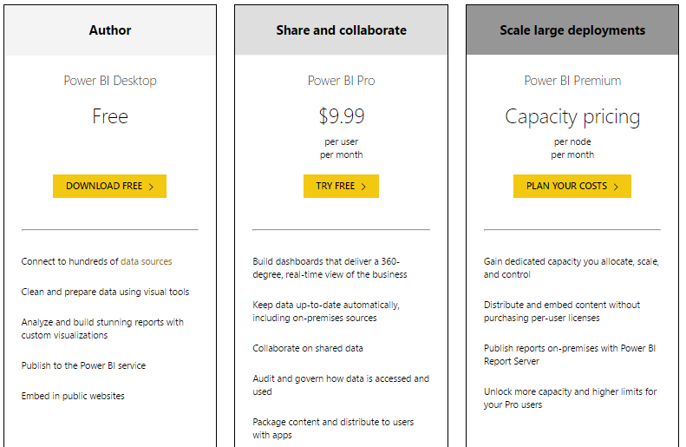
Power BI Pricing

Slide 5
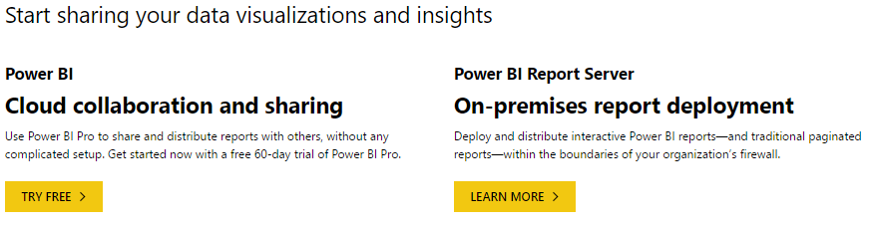
Two Solutions for Implementation: Cloud vs On-Premise

Slide 6
Method 1 to Connect to Project Online using PowerBI
On Premise Power BI
Using this Method
You need to create all report, dashboard from start.

Slide 7
To connect to Project Online database you need to have Project Online account before you proceed
Step 1: Download Power BI Desktop
Download Power BI Desktop, then run the installer to get Power BI Desktop on your computer.
Step 2: Connect to Project Online with OData
Open Power BI Desktop.
On the Welcome screen, select ﻿Get Data.﻿
Choose ﻿OData feed﻿ and select ﻿Connect﻿.
﻿Enter the address for your OData feed in the URL box, and then click OK.
URL Format: https://<tenantname>.sharepoint.com/sites/pwa/_api/Projectdata
Example: https://contoso.sharepoint.com/sites/pwa/_api/Projectdata
https://vedavit.sharepoint.com/sites/pwa/_api/Projectdata
Power BI Desktop will prompt you to authenticate with your Office 365 account. Select Organizational account and then enter your credentials.

Slide 8
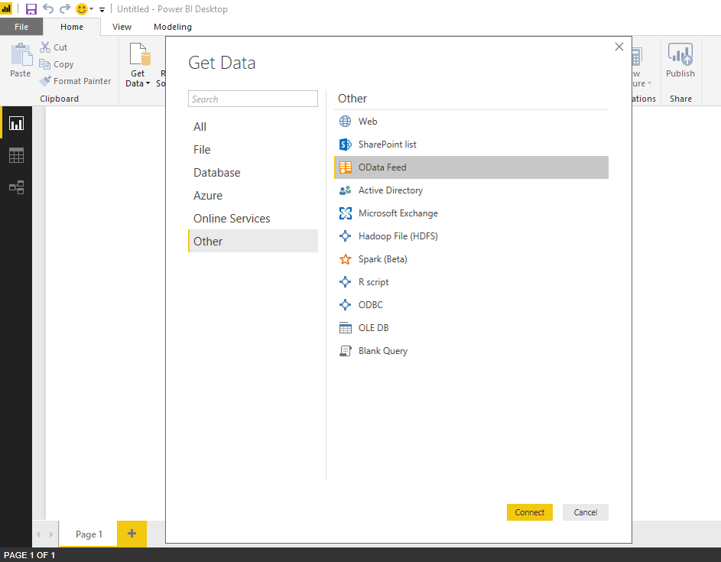
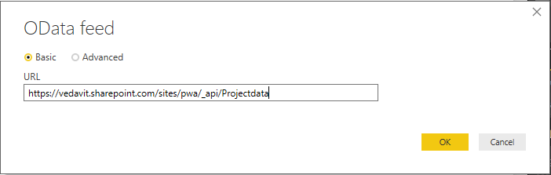
Connect to Project Online
1
2
3
4

Slide 9
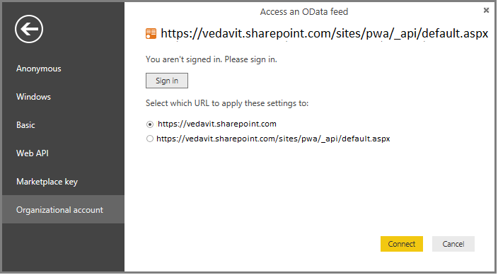
Connect to Project Online
You need to login here and authorize PowerBI on Project Online database to access the data. This is one time job.
After login. Click on connect to get access to all your Project Online data
Now you are connected to Project Online database. You can play around and create whatever report, chart, dashboard you want to create

Slide 10
Method 2 to Connect to Project Online using PowerBI
Cloud Collaboration
Using this Method
You get access to out of the box reports/dashboards

Slide 11
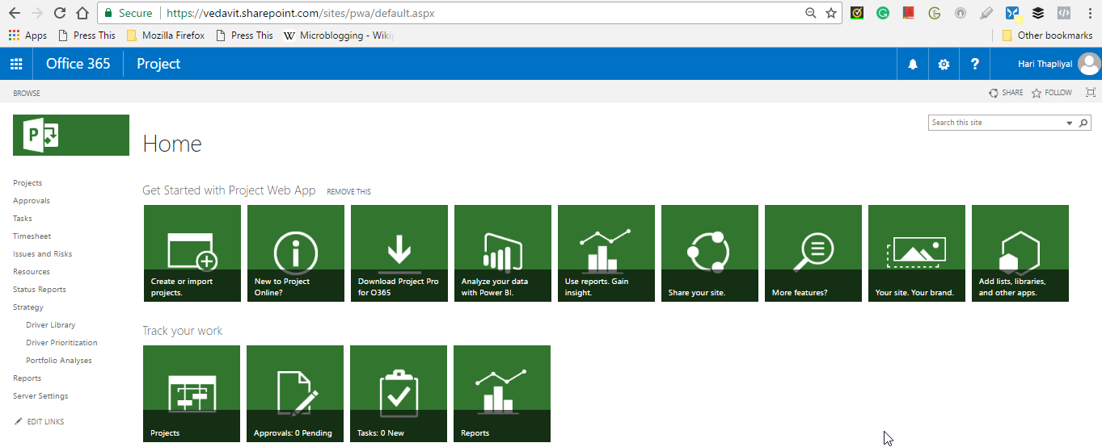
Launch PowerBI to See Project Dashboard & Reports
You need PowerBI Pro Account

Slide 12
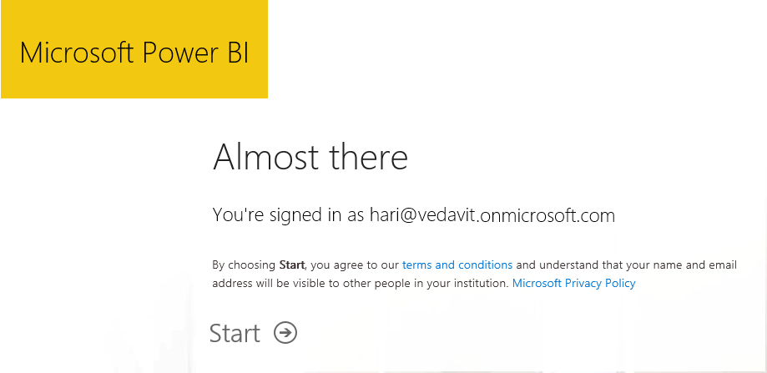
Login into to Office365 Account to Authenticate PowerBI to get your data

Slide 13
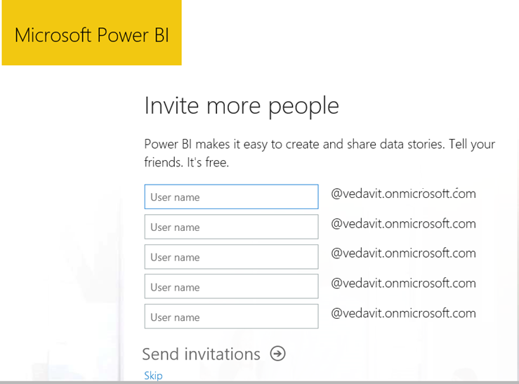
Click Skip on this page

Slide 14
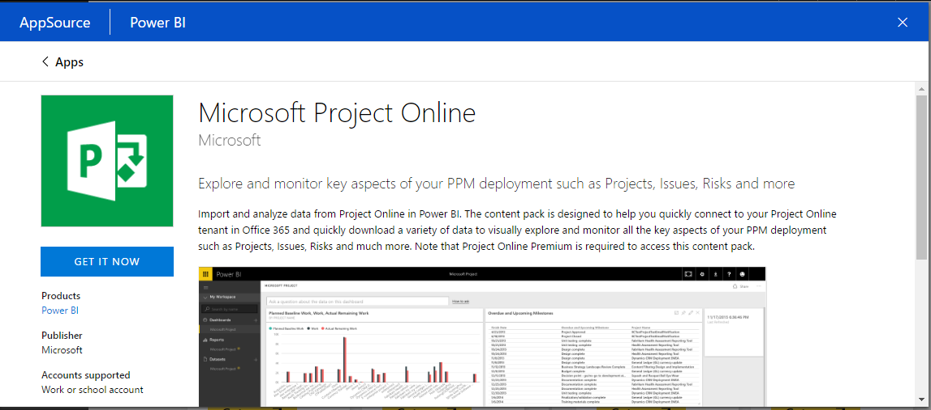
To Connect to Your Project Online Database Click “GET IT NOW”

Slide 15
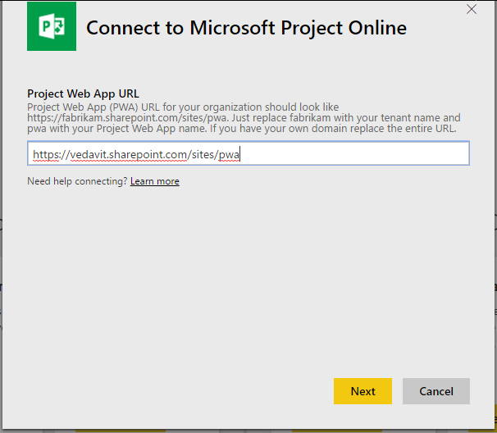
Enter your PWA URL
Replace “Vedavit” with your name, whatever you used to create PWA
When you purchase or get trial version of project, you need to register your details there. This name information is entered there.

Slide 16
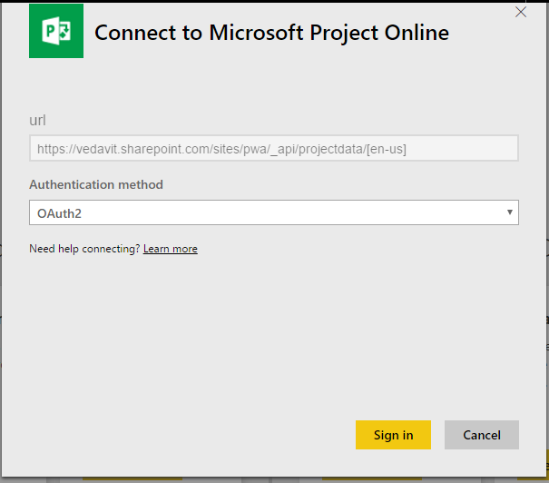
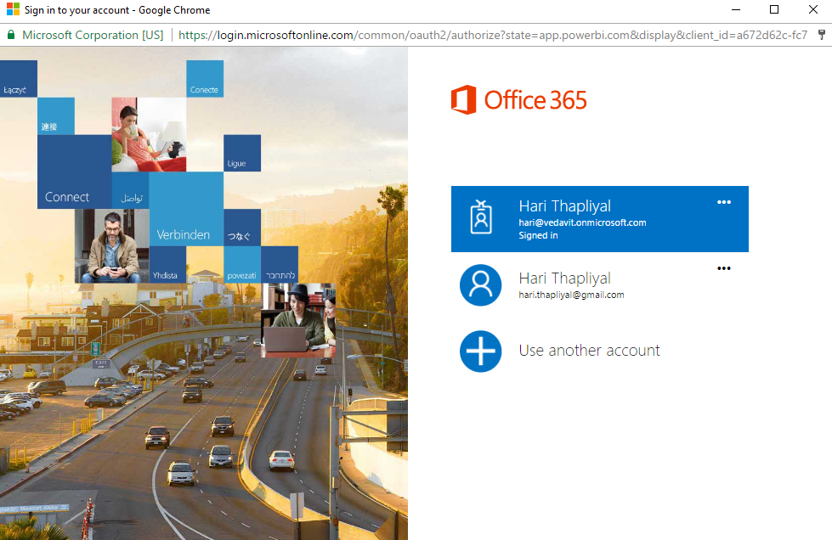
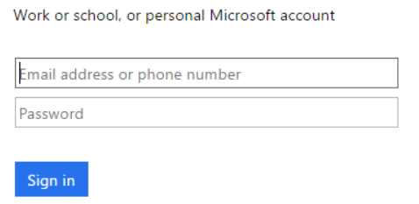
It takes some time and refresh extract the data from Project Online

Slide 17
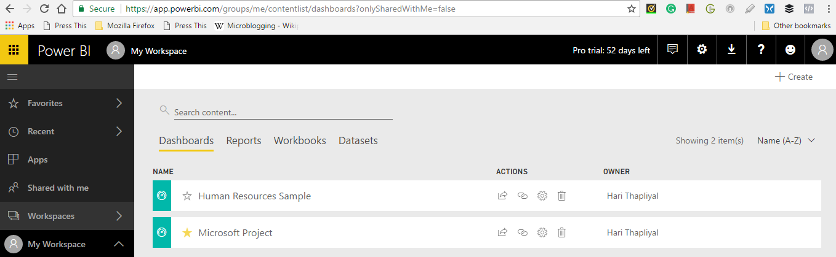
Dashboards
1

Slide 18
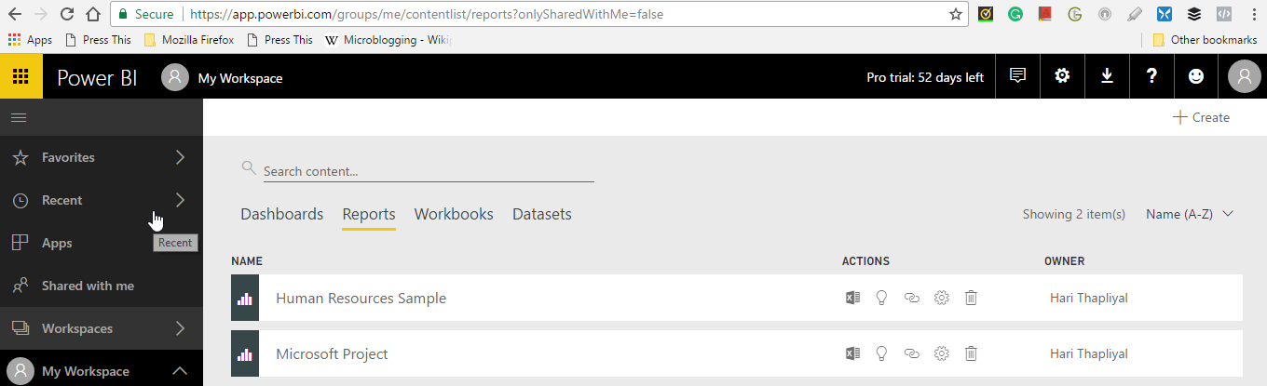
Reports

Slide 19
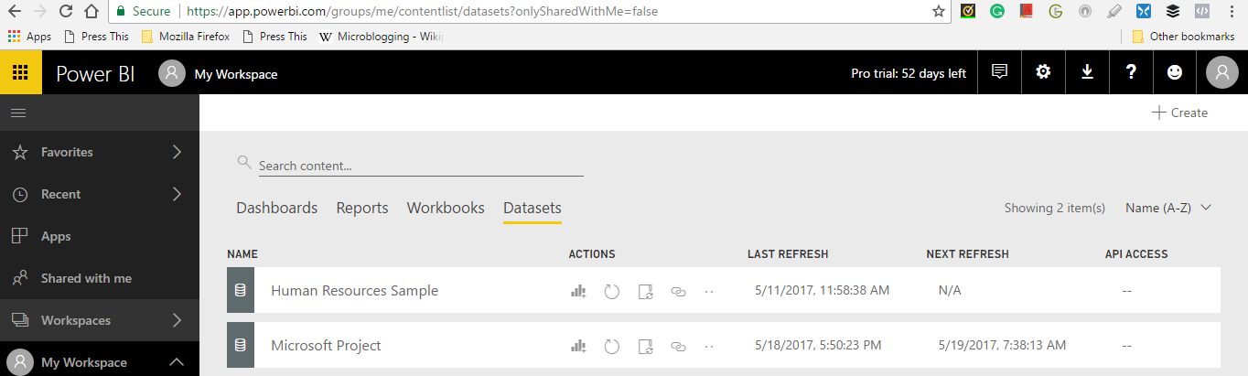
Dataset

Slide 20
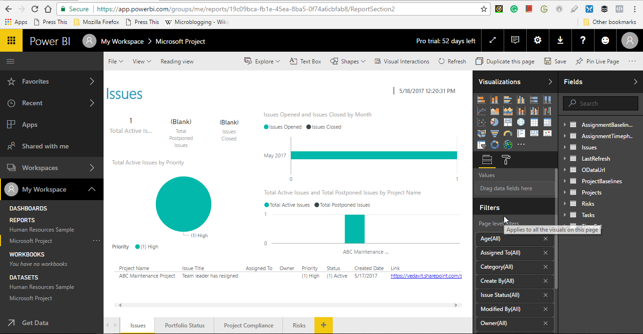
Report Layout Screen (Out of the box)
1
2
5

Slide 21
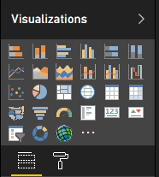
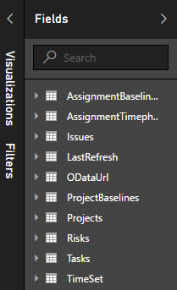
Microsoft Project - Power BI
Different type of charts and map you can use on reports and dashboard to present your data
Various tables and fields you can select to create meaningful dashboard and reports

Slide 22
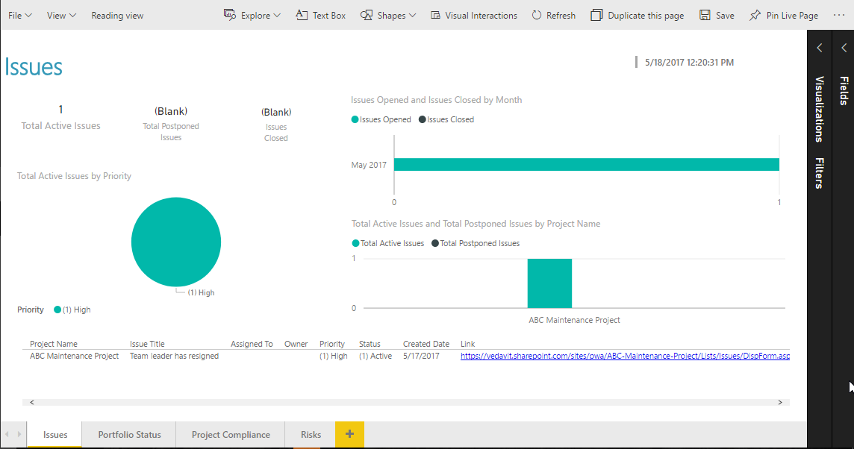
Reports-Issues (Pre-existing)

Slide 23
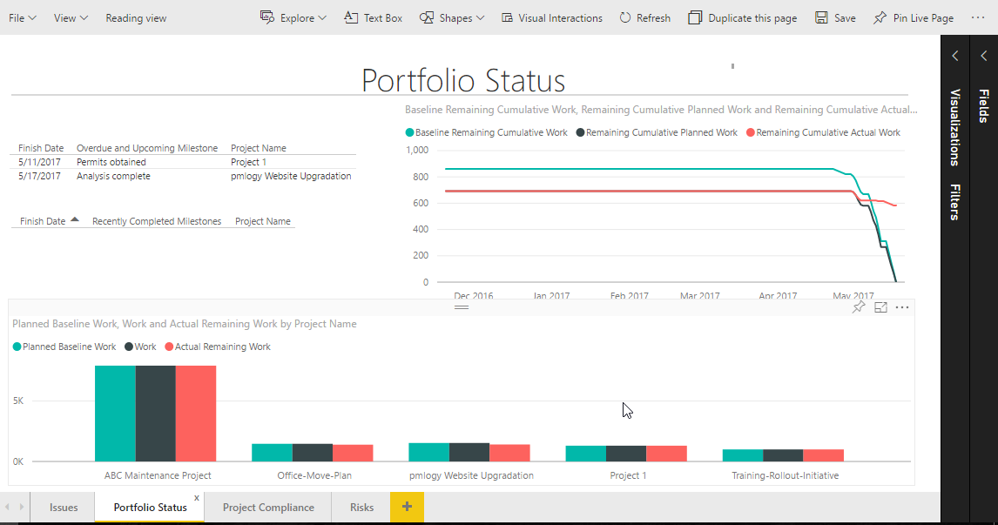
Reports-Portfolio Status (Pre-existing)

Slide 24
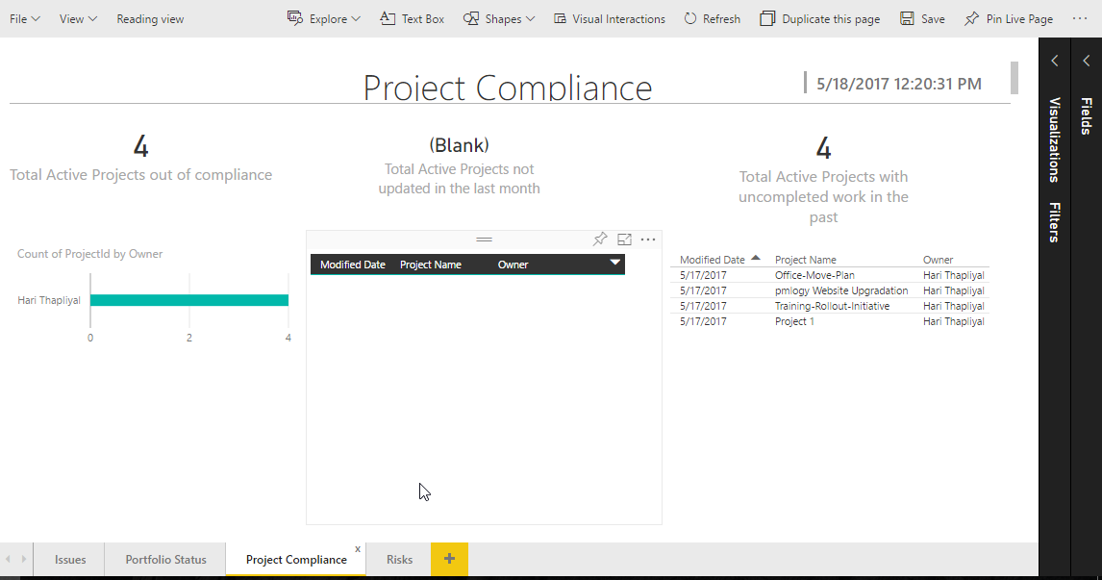
Reports-Compliance (Pre-existing)

Slide 25
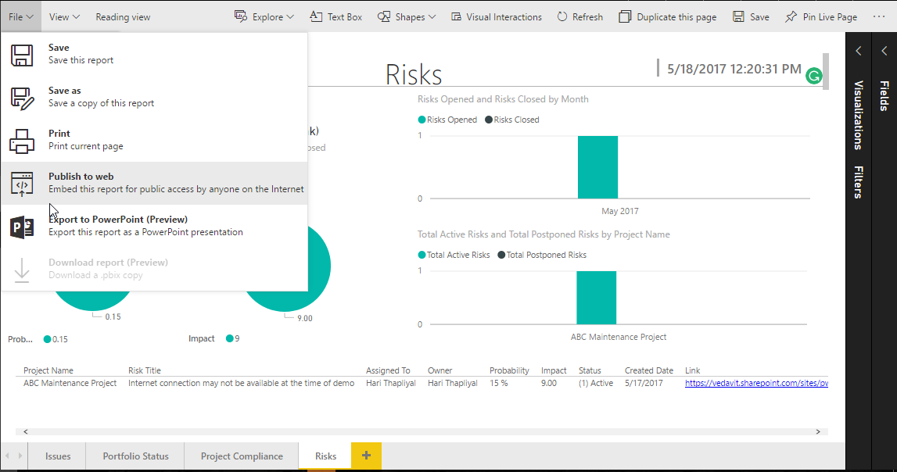
Reports-Risk (Pre-existing)

Slide 26
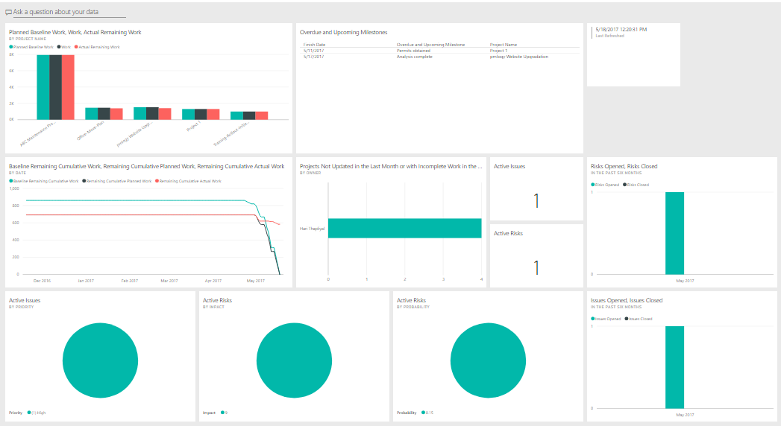
Dashboard (Pre-existing)

Slide 27
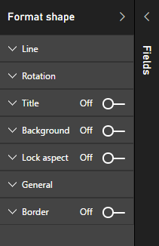
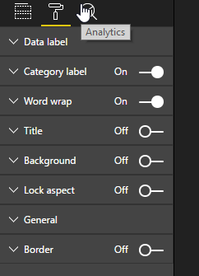
Shape and Field Formatter for Creating Attractive Dashboard and Reports

Slide 28








hari.prasad@vedavit-ps.com
+91 9535999336
https://in.pinterest.com/harithapliyal
https://www.instagram.com/thapliyal.h
https://in.linkedin.com/in/harithapliyal
http://twitter.com/pmlogy
http://pmlogy.com/
http://facebook.com/harithapliyalpage

